Slide 1
PROBLEM STATEMENT ANALYSIS :
Modern agriculture requires accurate and real-time data about soil and water conditions to optimize crop yields, conserve resources, and minimize environmental impact.
However, traditional methods of manual testing are time-consuming and may not provide the required granularity of data.
The system would assist in suggesting suitable crops and fertilizers based on the collected data through Machine learning.
To address this, we have developed an IoT-based(LoRa) Soil and Water Quality Monitoring Device that can accurately measure the required parameters. This device would be compact, easy to install, and capable of transmitting data to a central server.
Main advantage of this system is that we can have ‘N’ number of nodes connected to a single Gateway.

Slide 2
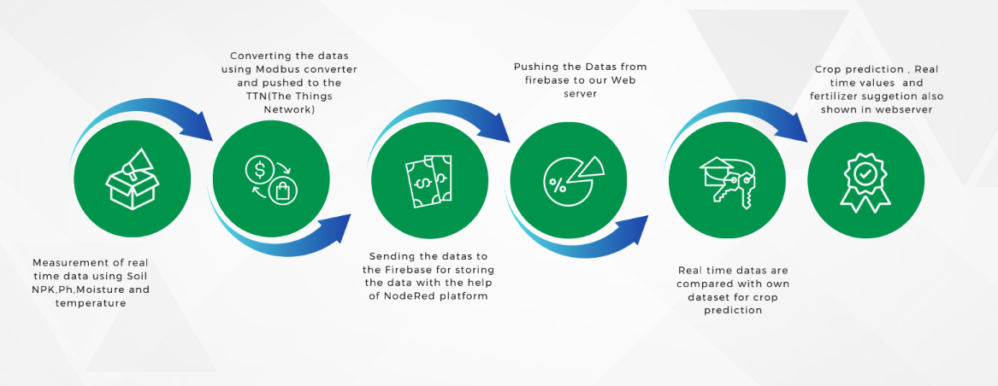
UNIQUENESS :

Slide 3
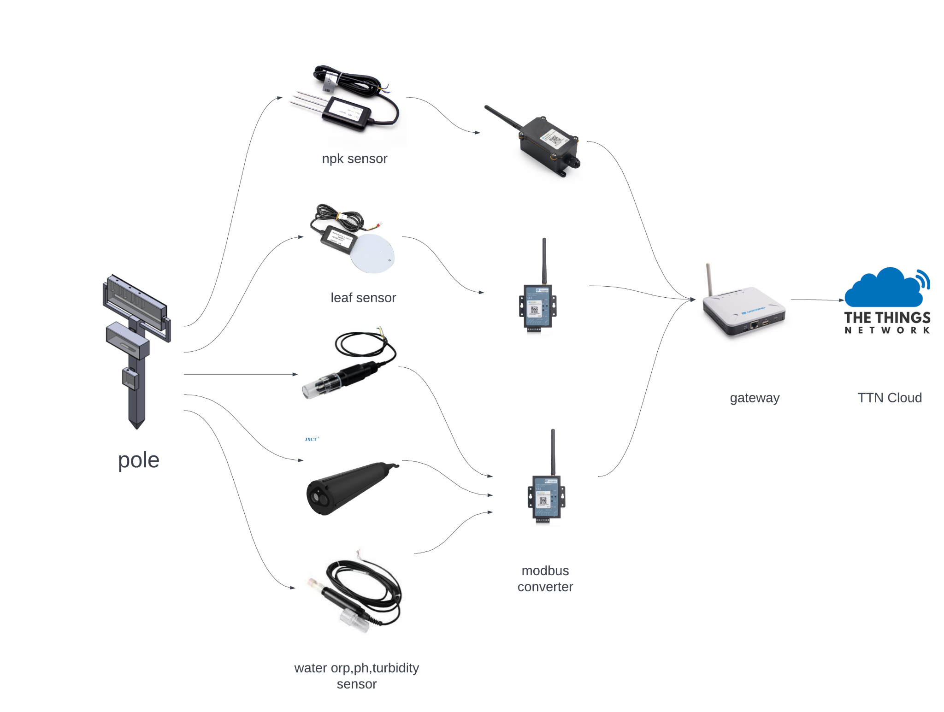
DESIGN AND METHODOLOGY :

Slide 4

METHODOLOGY :
DEVELOPMENT PHASES:
Conceptual and planning:
1).Preliminary discussions on generation of idea and concepts related to the project.
2).Conducted market research to identify the needs and competitors.
Design and prototyping:
1).Developed a detailed system architecture and design specifications.
2).Designed a prototype of the platform, integrating core components.
Technology Integration:
1).Implemented the LoRa network integration for real-time data transmission.
2).Developed interfaces for connecting various sensors(NPK,pH,leaf,water ORP)
Data collection and crop suggestion Algorithm:
1).Ensuring the collection of Real time data and storing it for further analysis.
2).Development of Machine learning algorithms for real time data analysis for crop suggestion.
Automation and user-interface:
1).Development of a webpage which can visualize the Real time data along with the automated crop suggestion.
2).Water automation is also done with respect to the real time data received.

Slide 5
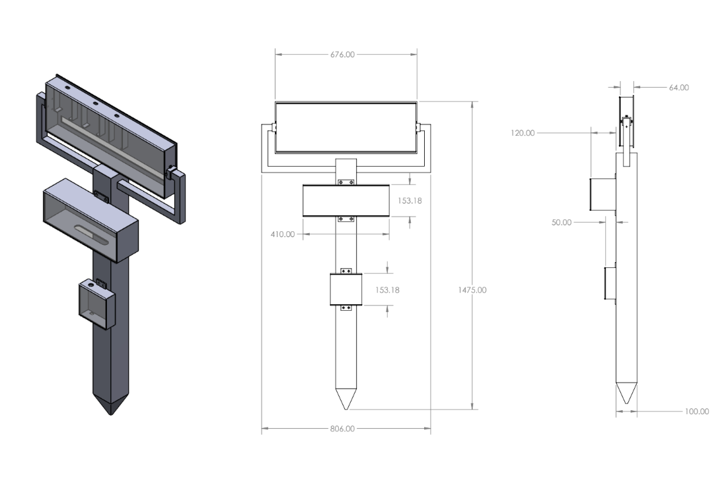
EXPECTED FINAL OUTCOME :
Prototype Design:

Slide 6

Demo video:

Slide 7
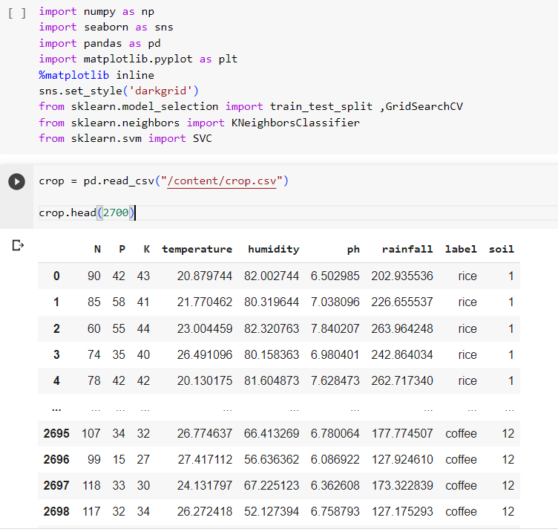
Machine learning (train and test the data)

Slide 8
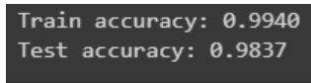
By using KNN algorithm got 99% accuracy
COLAB FILE LINK

Slide 9
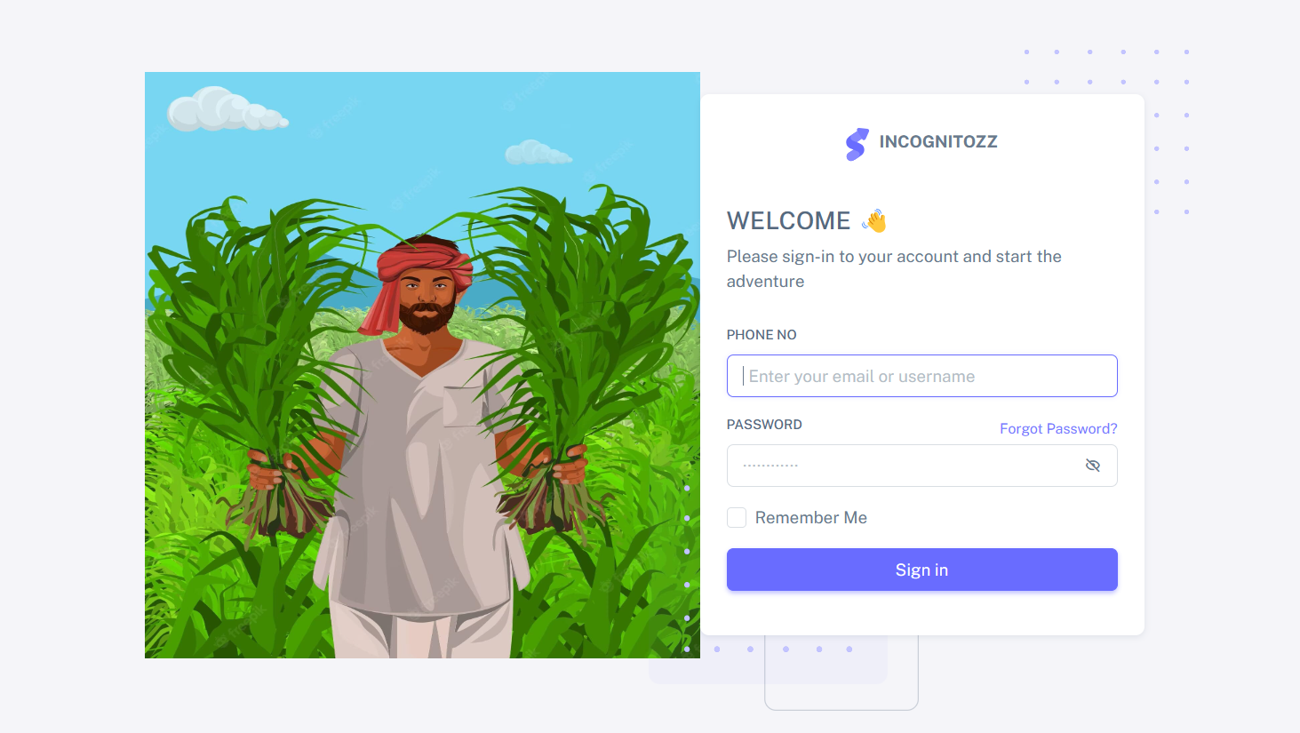
Web page Image(Login page):

Slide 10
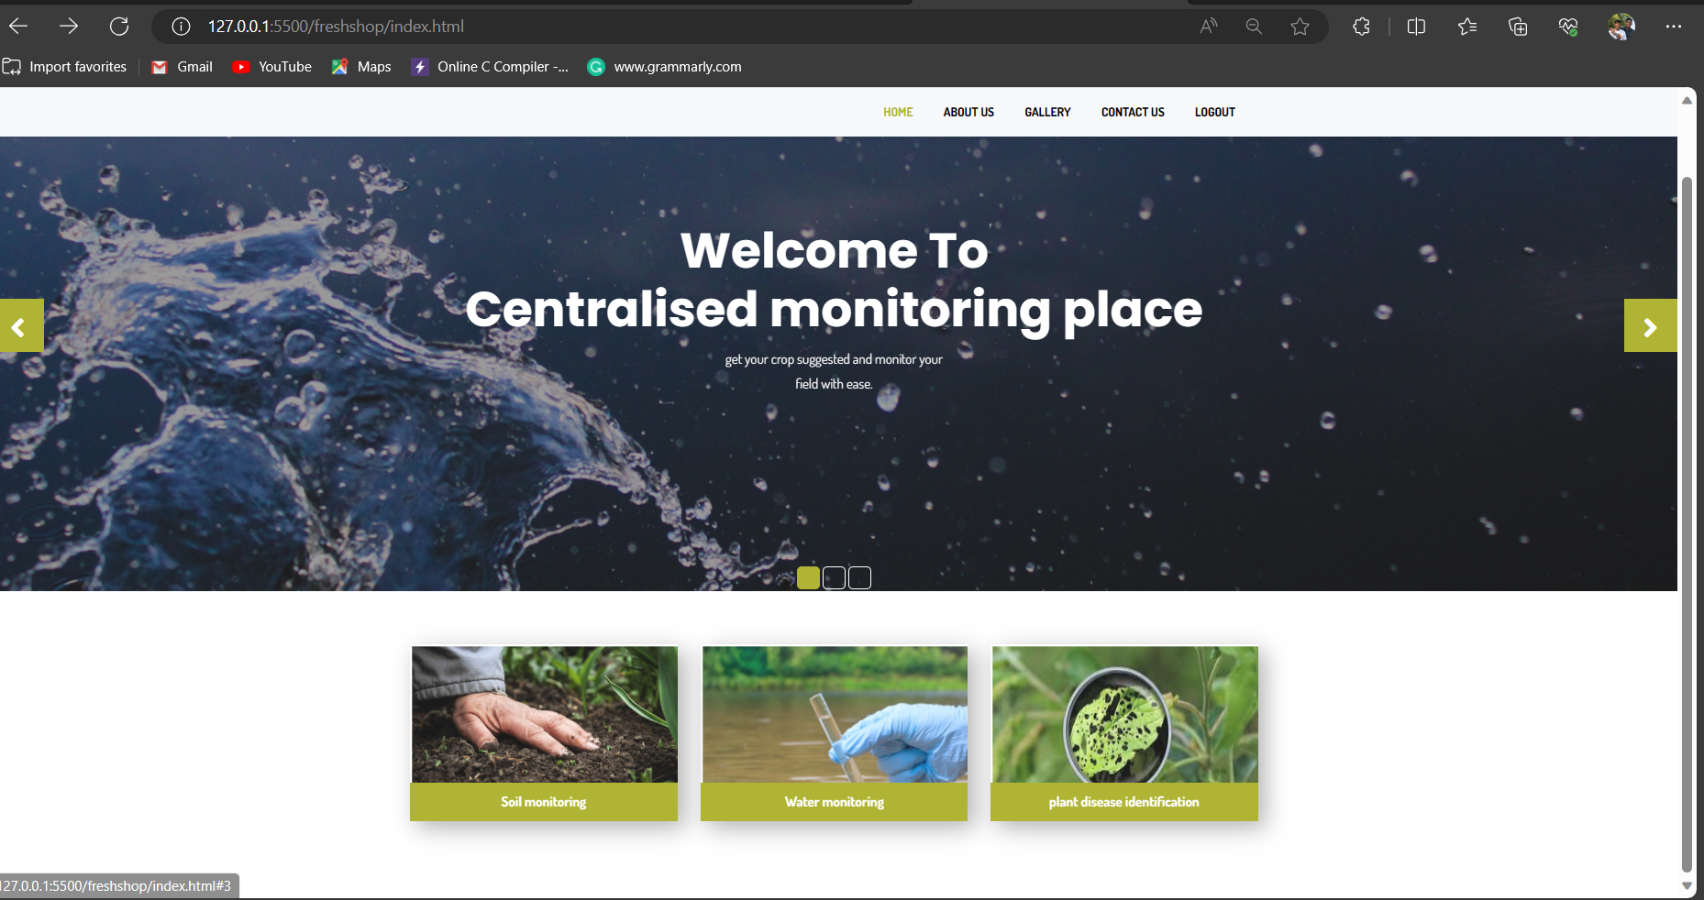
Web page Image(Index page):

Slide 11
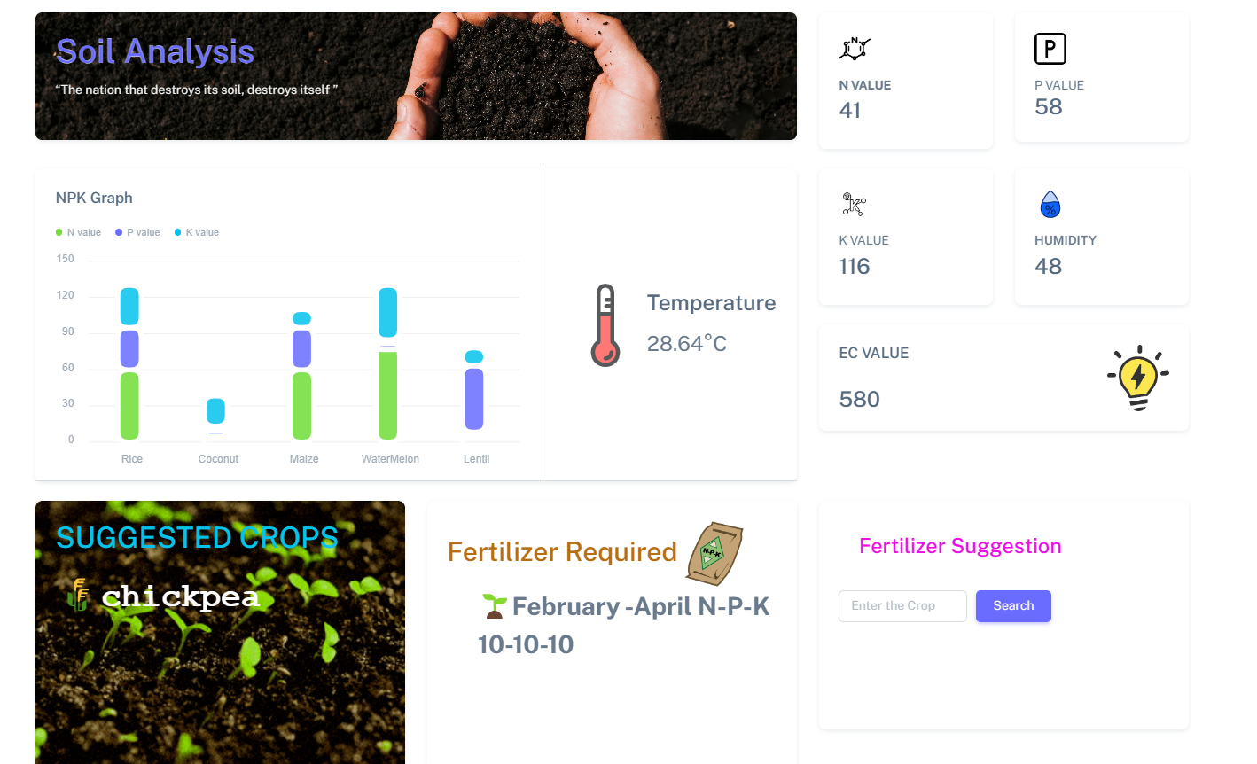
Web page Image(soil analysis):

Slide 12
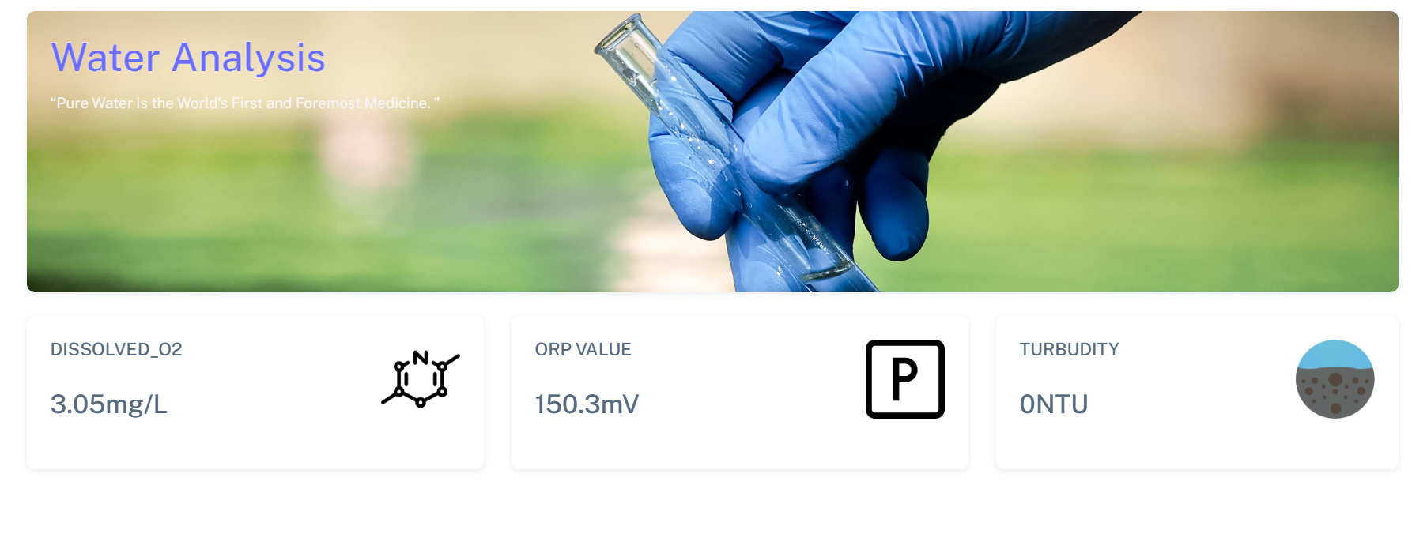
Web page Image:(water monitoring)

Slide 13
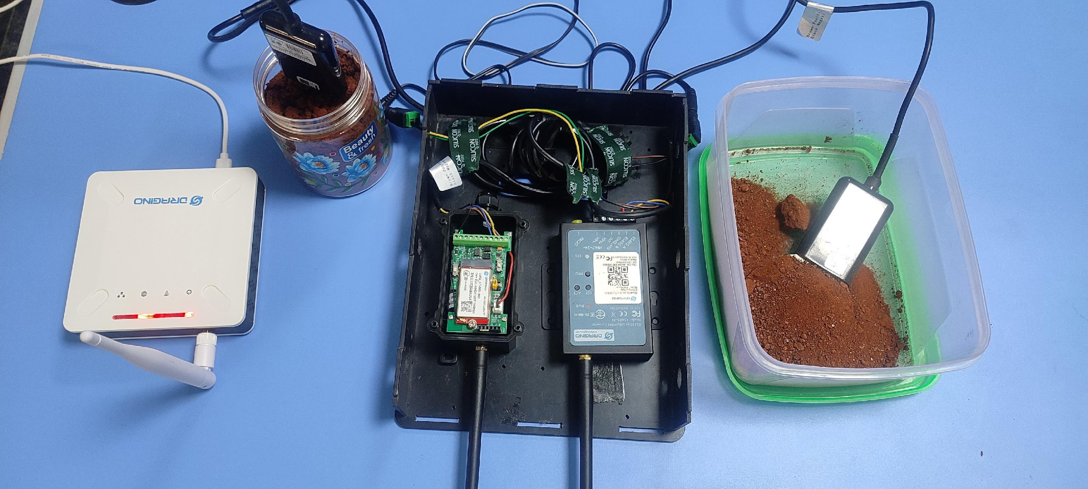
Hardware Image:

Slide 14
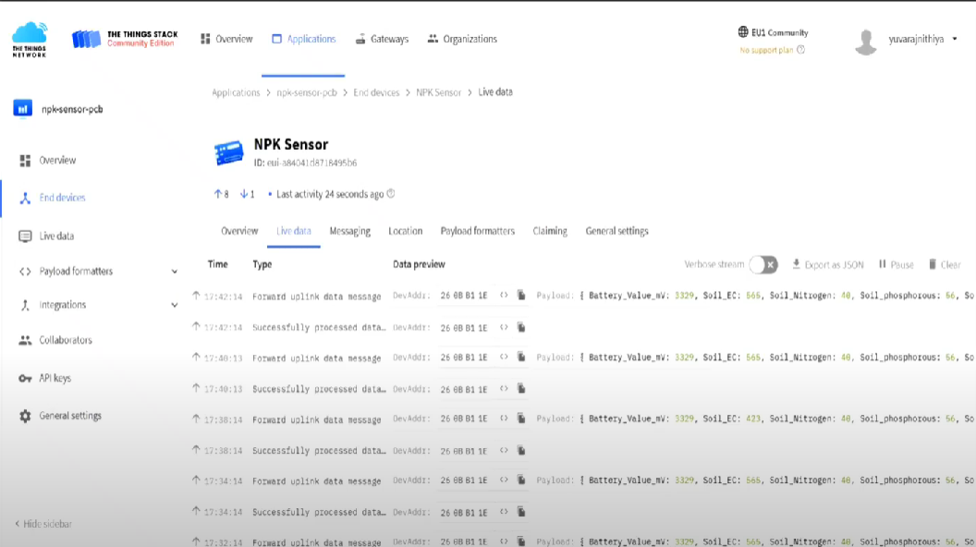
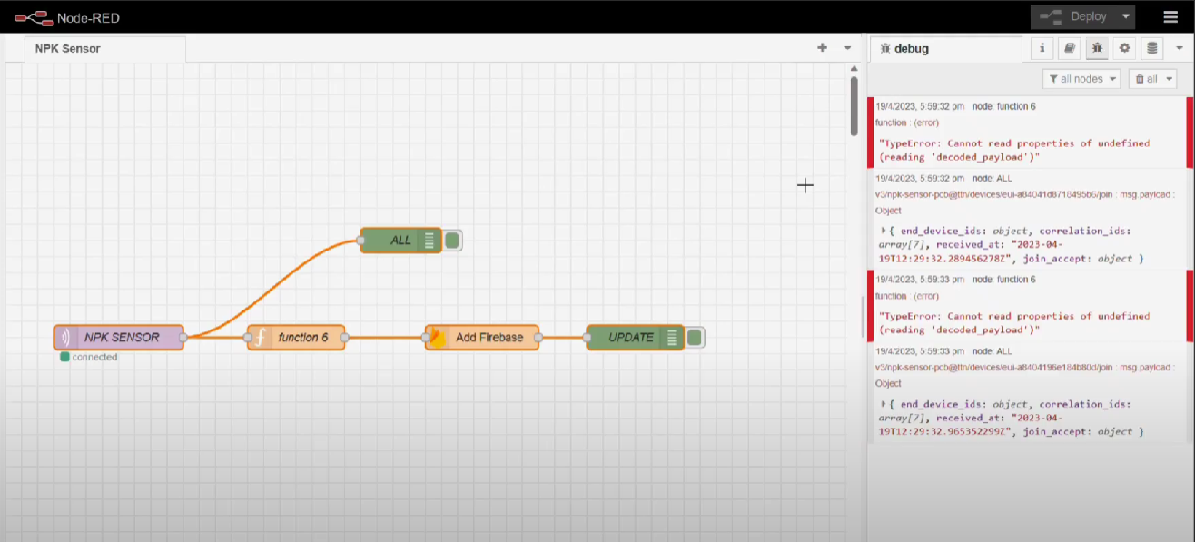
Data traversing:

Slide 15
TECHNOLOGY / SKILL REQUIREMENT - CONTRIBUTOR MAPPING:
S.No | Skills / Technologies Required for the project | Team member’ s Name (Contributing the required skill / technology)
1 | LORA technology-hardware (Electronics and Embedded C) | YUVARAJ N NARENDRA J
2 | Machine learning (development of Algorithm) | MALATHI M ARJUN R
3 | Web development and 3-D Modeling | VISHNU PRASATH S P MANOJ PRABHU R

Slide 16
GANTT CHART :
DEVELOPMENT:
TASK | WEEK 1 | WEEK 2 | WEEK 3 | WEEK 4 | WEEK 5
Design
Requirement
Development
Testing
Final Outcome

Slide 17
THANK YOU

